Slide 1

Website development to help NGO spread it’s awareness
By TEAM One_piece

Slide 2
Intro of member of One-piece
Myself:- Harshit Kandpal
2nd member:- Aarya Kamble

Slide 3
Solution
Workflow
Registration Page
Landing Page for NGO’s
Dashboard

Slide 4

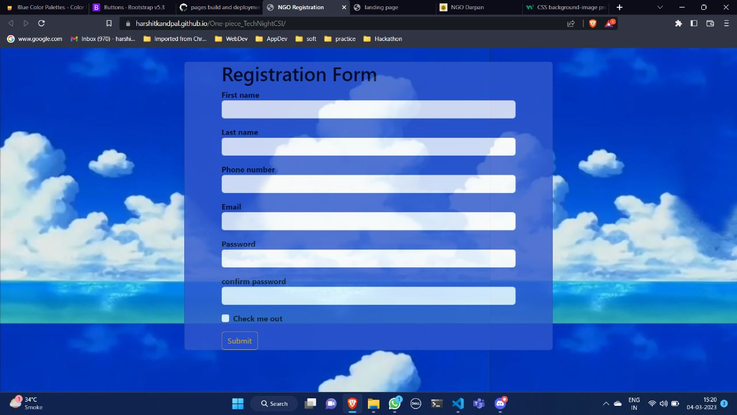
REGISTERATION PAGE
This site is a standard registration page for volunteers.
https://harshitkandpal.github.io/One-piece_TechNightCSI/

Slide 5
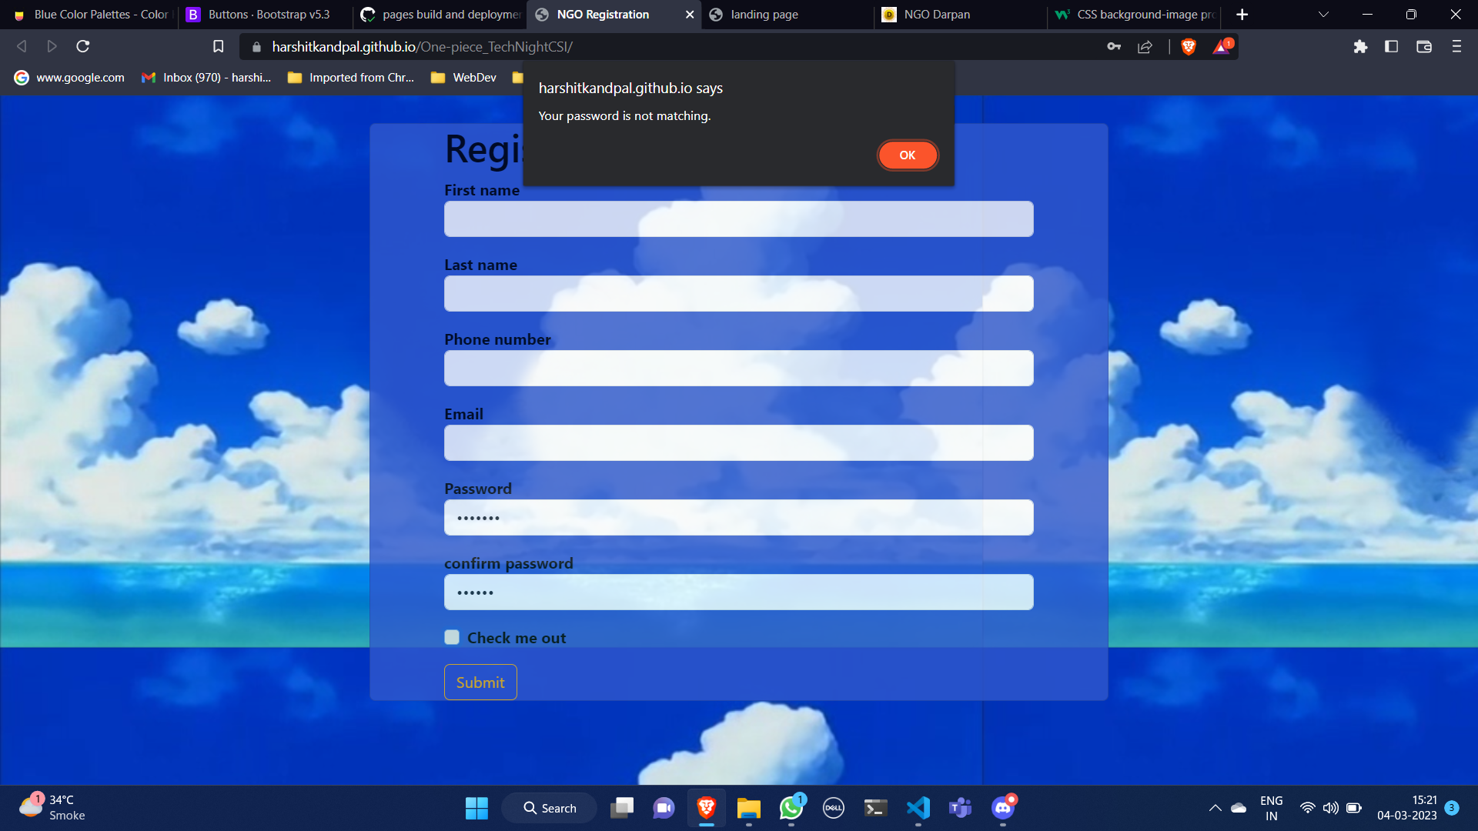

Slide 6
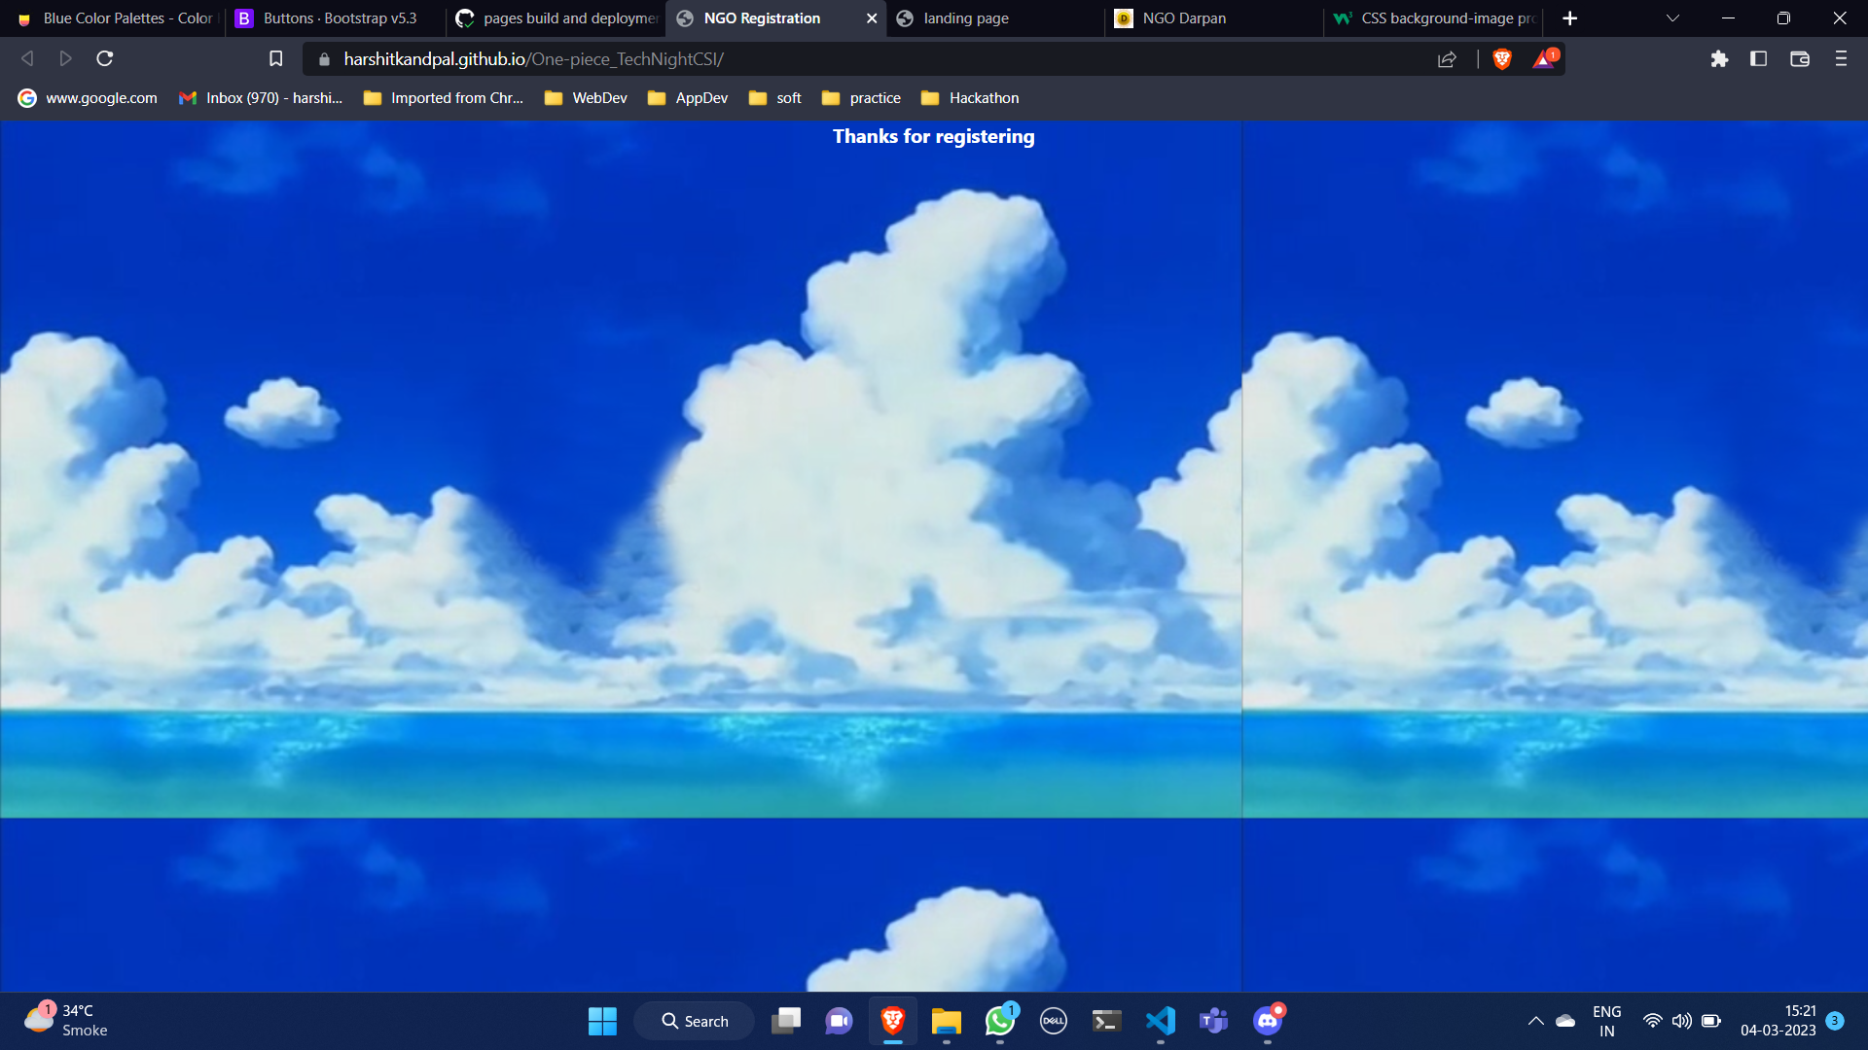

Slide 7
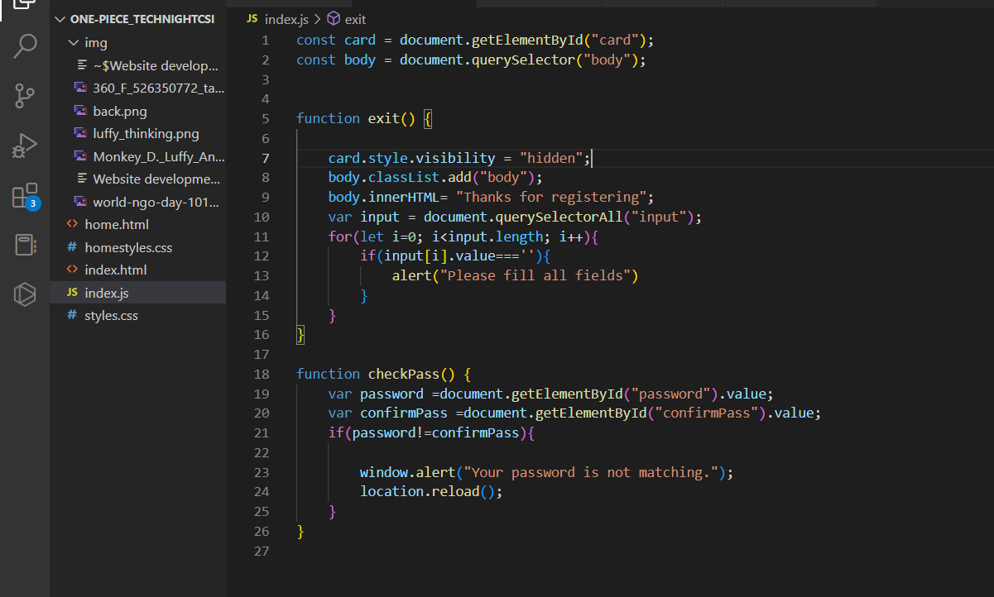
Flow Diagram

Slide 8

Index.html/landing page
Coming soon

